Slide 1

Notes:
Good afternoon. First we would like to thank Mr. John Smith and the executive team a from Flyhomes for having us today. We are Solaris and our moto is “Your peace of mind is our business”.

Slide 2
Today we will cover
Getting to know the team
Problem domain and solution overview
Team process and documentation
Application demonstration

Slide 3

Our Team
Jenae Bierlink
Gregory Haven
Kevin Isaac
Alex Wise
Notes:
Our team is comprised of United States armed forces veterans representing 3 of the 6 branches. This mutual background is a huge advantage as were used to adaptation and overcoming any and all challenges that arise with no conflict while keep each other accountable. The Solaris team members are……………and with that we will turn the mic over to Jenae for her introduction…..

Slide 4
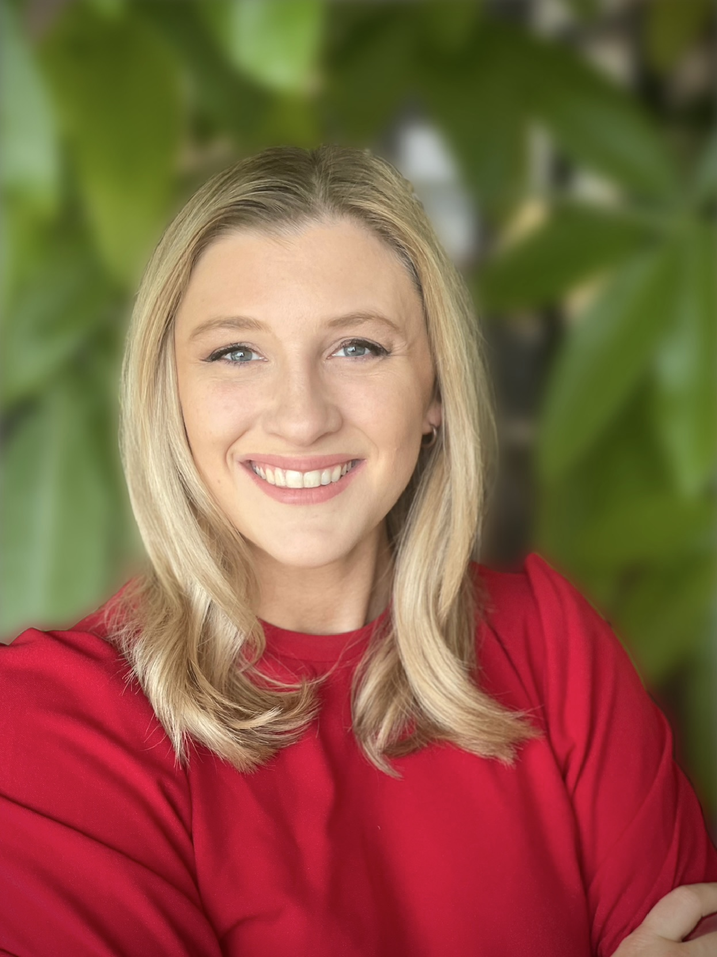
Jenae Bierlink
Co-Founder of Solaris
Cybersecurity Analyst
Air Force Veteran - Cryptologic Linguist
Bachelor's degree in Organizational Management
15 years of professional experience in analytics
and curriculum development

Slide 5
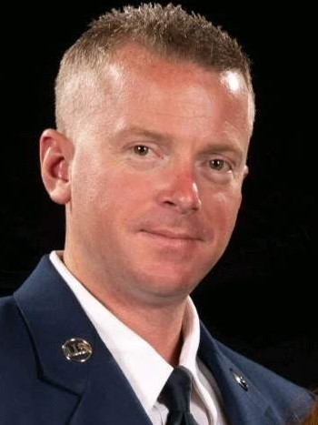
Kevin Isaac
Co-Founder of Solaris
12 year Air Force Veteran working on the
weapons Systems of F-16s
Network Security Engineer
Strong Leadership Skills

Slide 6
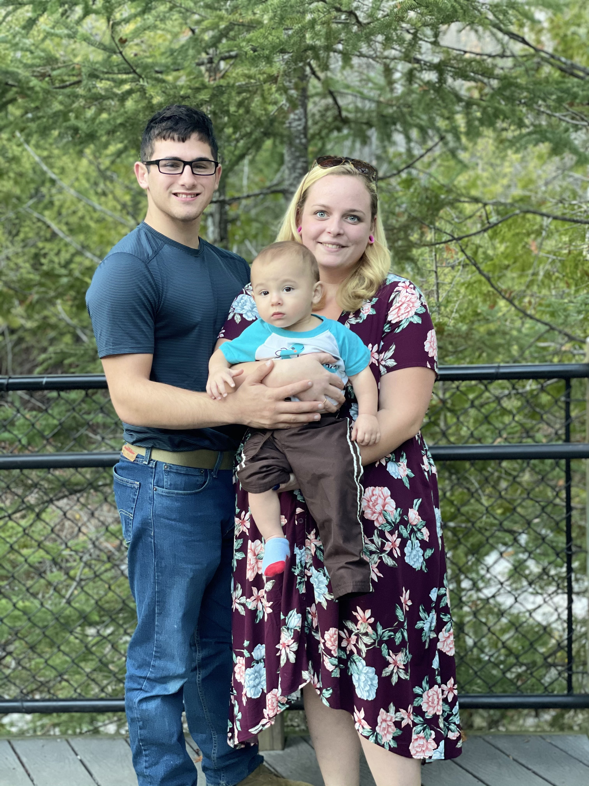
Gregory Haven
Co-Founder of Solaris
Cybersecurity Specialist
Originally from Standish, Michigan
Army national guard reservist

Slide 7
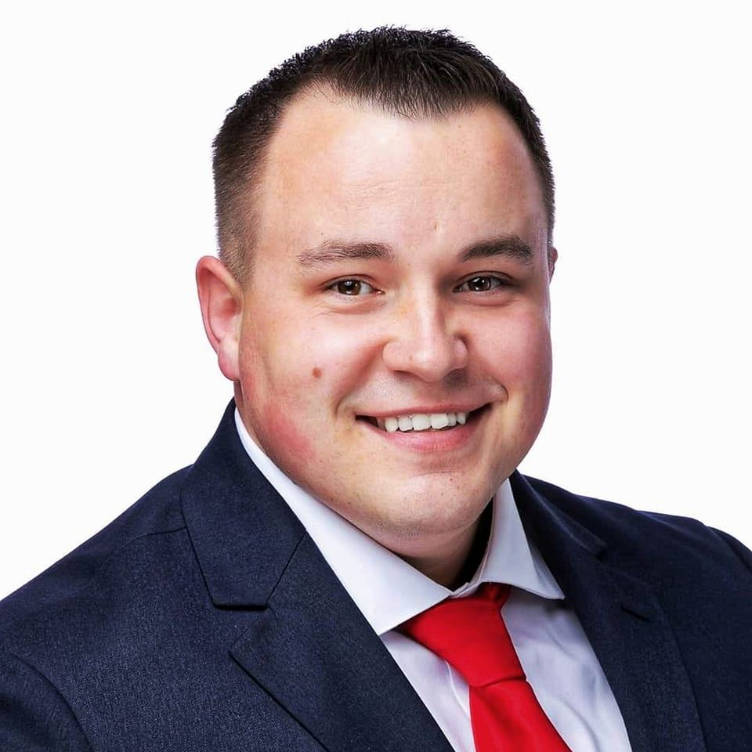
Alex Wise
Co-Founder of Solaris
United States Marine with experience in communications and encryption
Physical penetration tester
Extremely detail oriented
Notes:
Im Alex Wise, Also a co founder here at Solaris. I am a United States Marine with experience in Communications and encryption. My role is as a Physical Penetration tester is suited to me due to me as I am extremely detail oriented and thurogh.

Slide 8
The Problem Domain
Primary Mission: Flyhomes needs a secure and remotely available file server for storage of company proprietary information
Secondary Mission: development of a Windows 2016 Server with AWS cloud services integration for a special project
Notes:
Upon speaking with the Flyhomes executives we derived two situations we believe we could help with. These ae our missions……READ MISSIONS 1 AND 2……..

Slide 9
Mission Overview (In order)
Primary Mission
Develop Linux based file server/ Virtual machines
Integrate Virtual machines and Linux servers on same network
Integrate Gmail accounts with Thunderbird
Establish remote connectivity for Virtual Machines/ Servers
Mount Linux file server
Automatically back up user profile and operating systems
Secondary Mission
Develop Windows 2016 File Server
Integrate with AWS EC2 cloud services
Notes:
We will accomplish the mission by … and with that I will Turn the mic

Slide 10
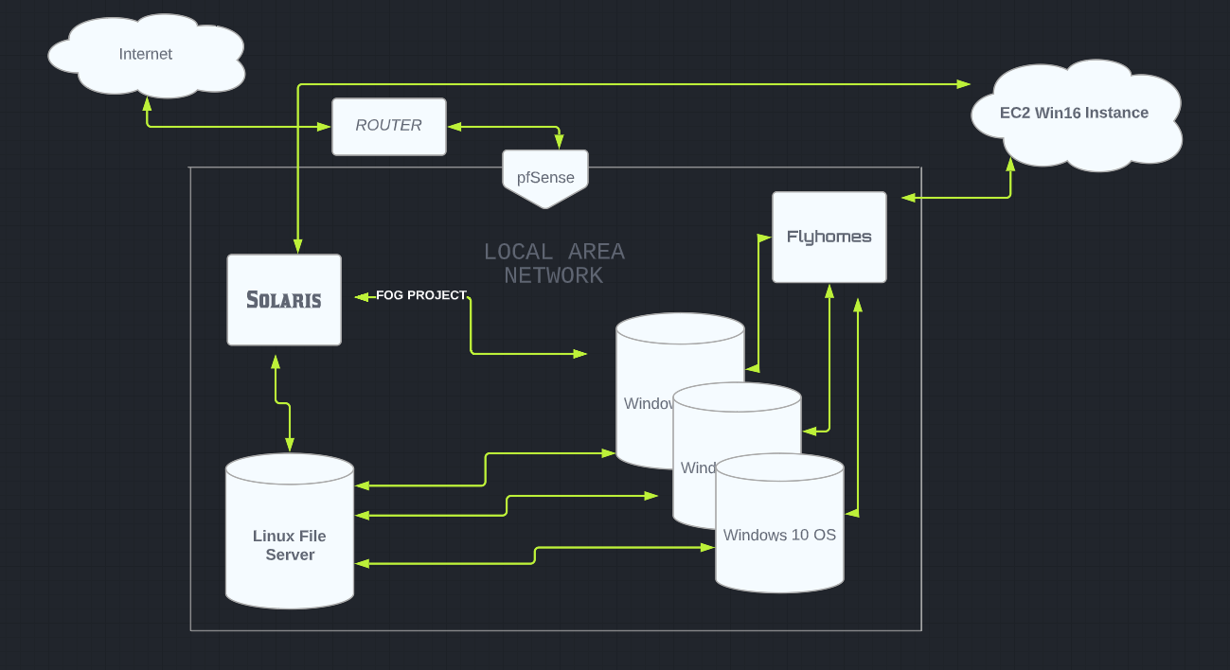

Slide 11
GETTING YOUR EMPLOYEES SET UP FASTER
PXE boot
Fog Project
Computer imaging solution
Quickly deploys Windows 10 Operating Systems

Slide 12
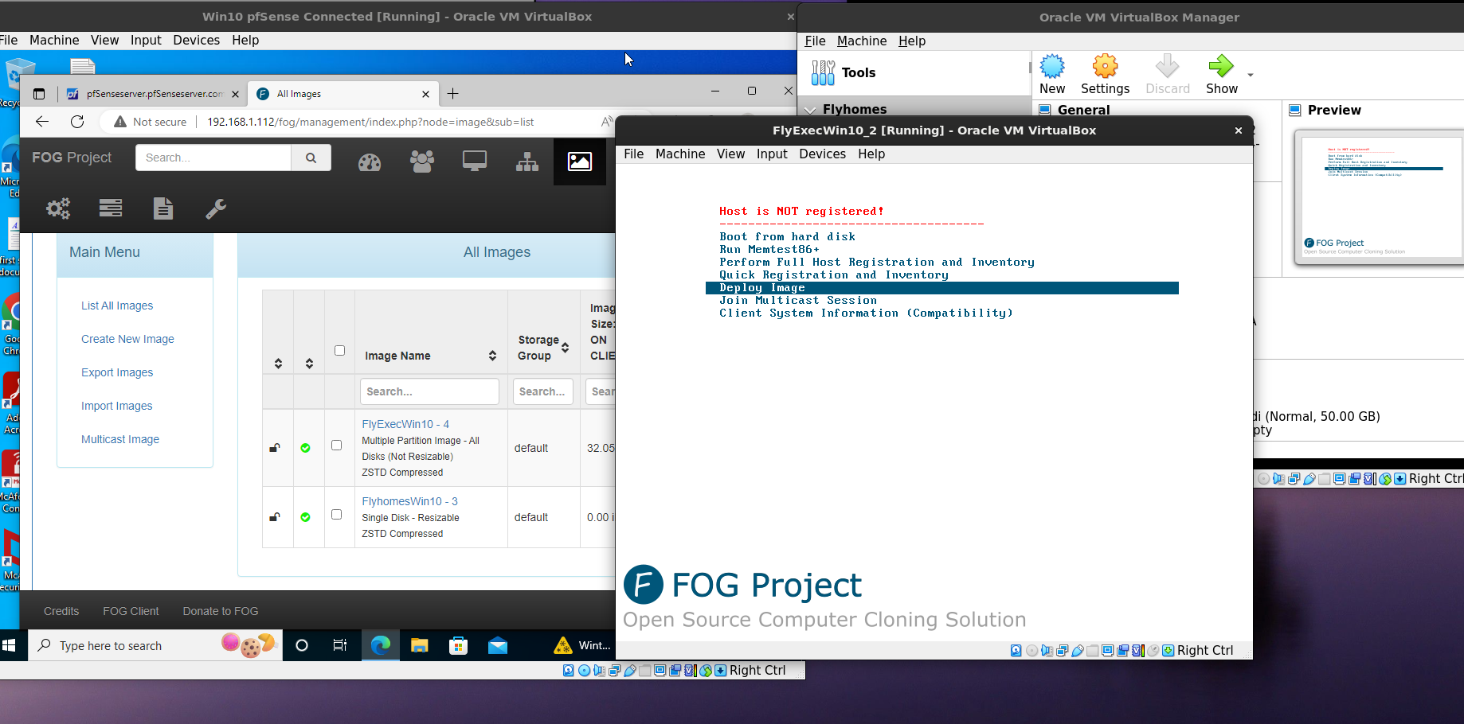

Slide 13
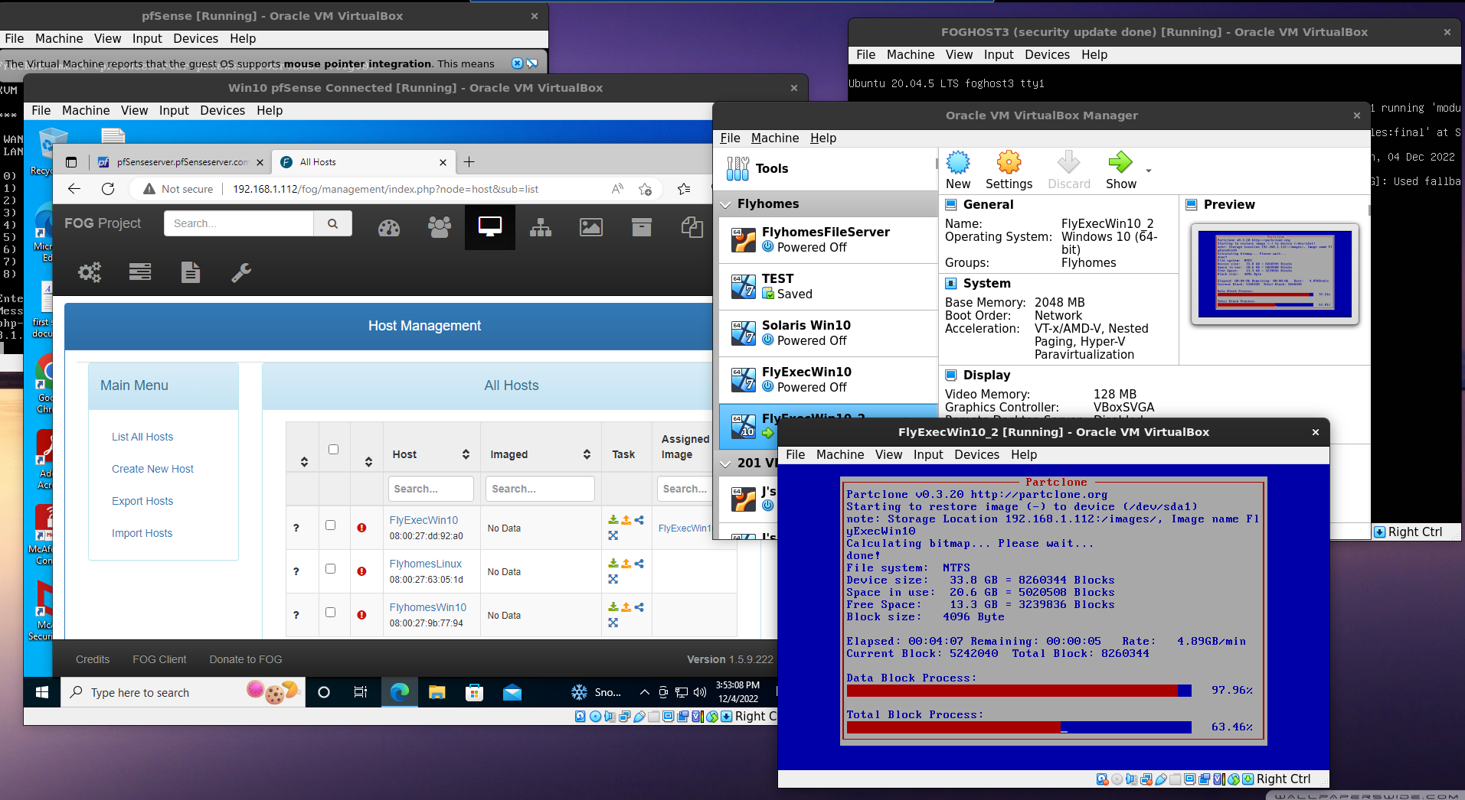

Slide 14
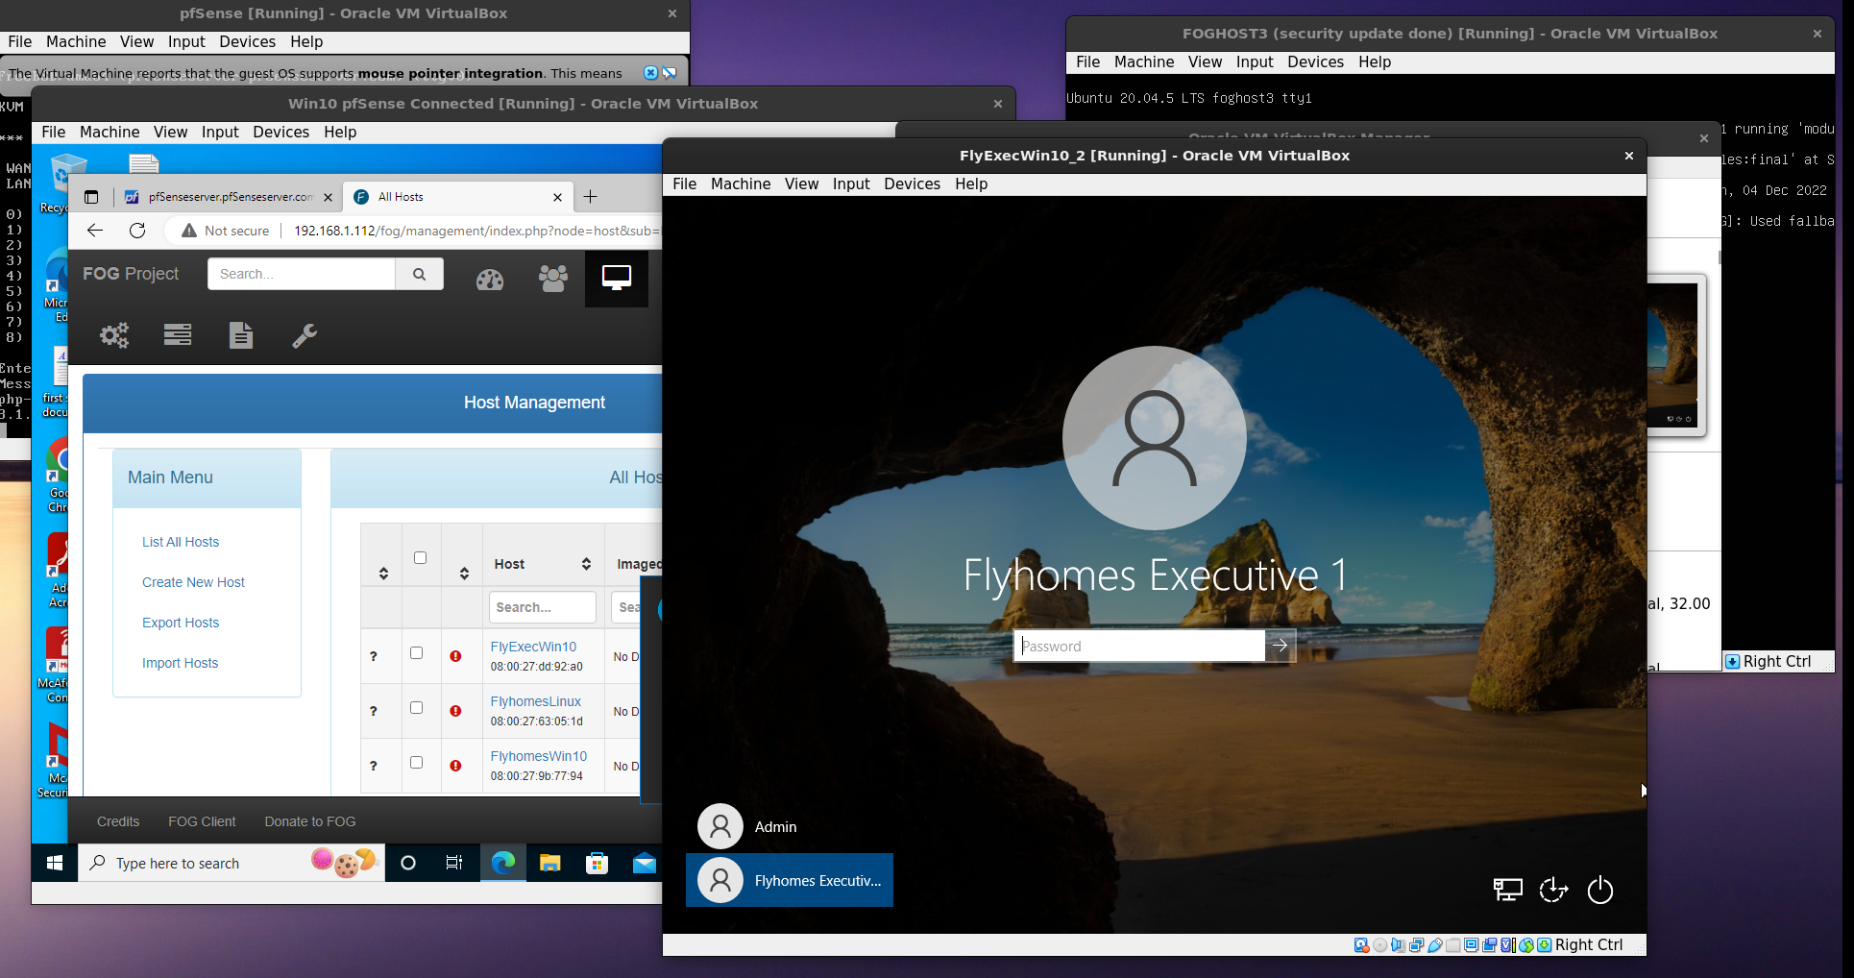

Slide 15
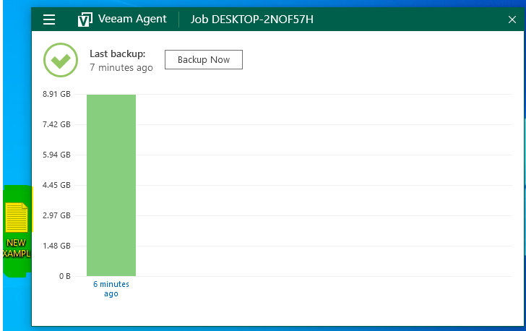
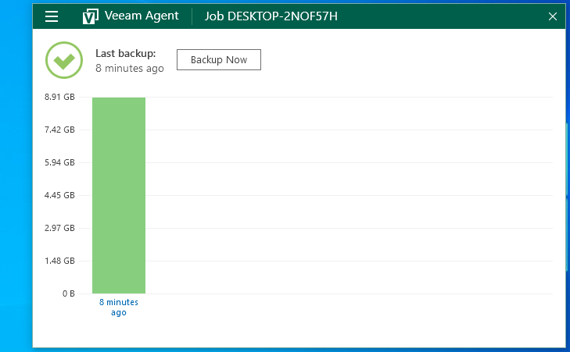
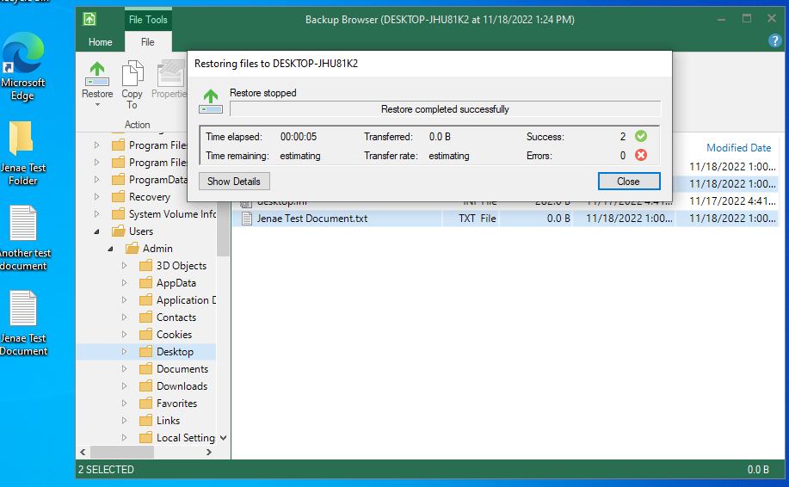
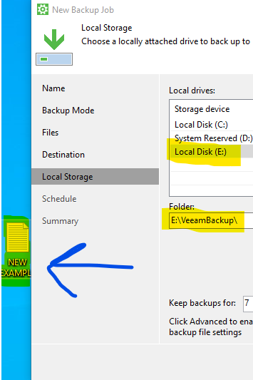
Back-Up and Restore
Employee Profiles Backed Up Nightly
Operating System Backed Up Weekly

Slide 16
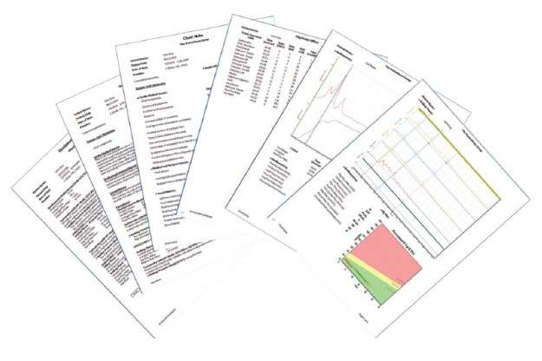
Employee Onboarding Automation
Blueprints
Flyhomes Standard Operating Procedures
Model Homes
Orientation
Shipping
TPS Reports

Slide 17
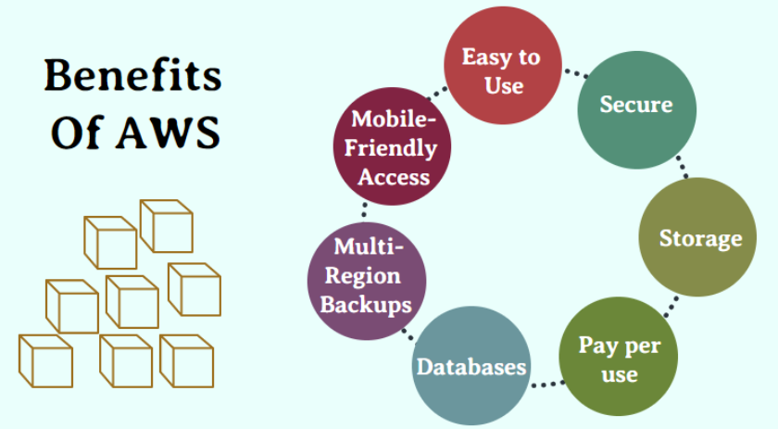
Alex Wise Presentation and documentation
Mobile Friendly- AWS SDK and AWS Mobile hub
Easy to use
Secure- Industry standard when it comes to keeping your proprietary data safe and accessible
Storage- Multiple storage sources that act as reunifies so your business is never down. Examples include EBS, Glacier, S3 and Elastic file system
Pay Per Use- Your only paying for what you use which is budget friendly and presents a positive ROI
Multi region Backups- Centralized solution to store a copy of backup data more than a region away from production area.
Multiple in house managed databases
Notes:
For the Special project we as a team decided to develop a Windows 2016 Server with AWS cloud services integration. Here are some of the benefits of AWS

Slide 18
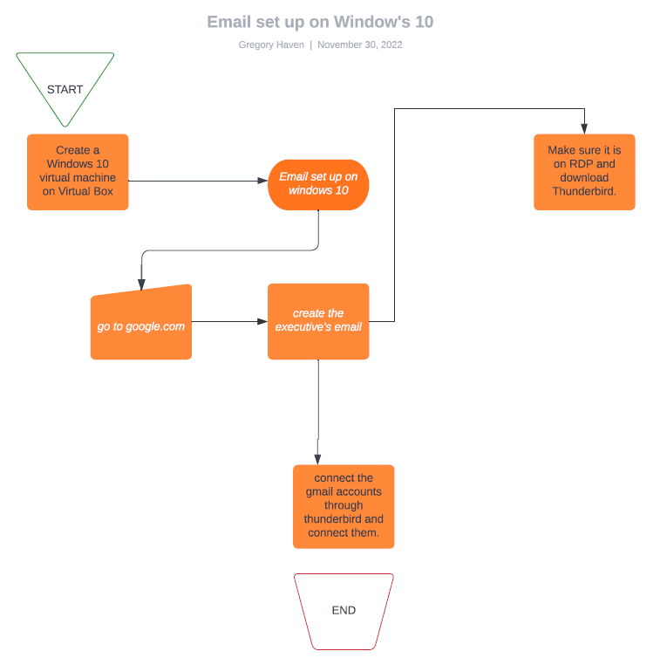
Email Topology
Notes:
For the Special project we as a team decided to develop a Windows 2016 Server with AWS cloud services integration. Here are some of the benefits of AWS

Slide 19
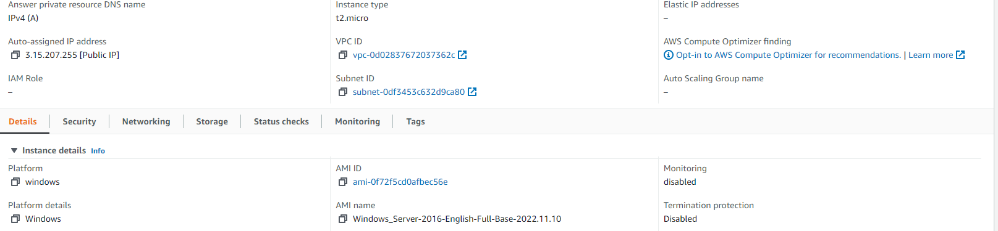
Windows 2016 with containers
Notes:
Now We here shows the developed Windows 16 server. I will send your AWS management console credintials with our Solaris onboarding package.

Slide 20
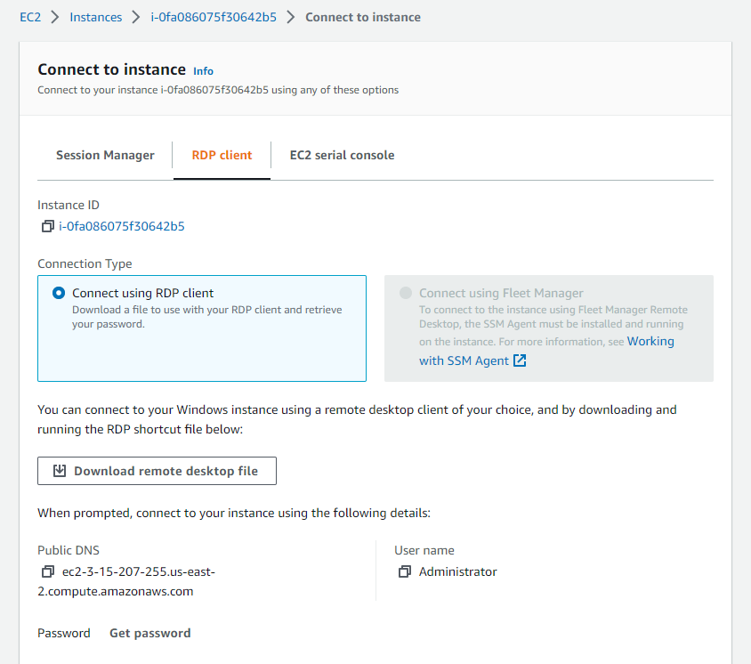
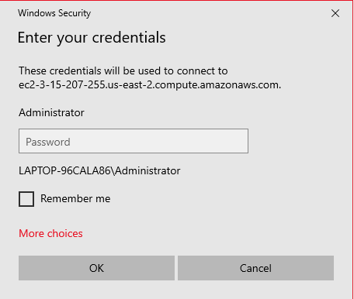
How to “Remote”in
Notes:
When you login you will see a option for EC2. Click that option and this menu will appear. Click the download RDF button and AWS will automatically download a remote sofeware at which you will be asked your PC credentials to begin.

Slide 21
QUESTIONS

